Slide 1


Slide 2
Chapter 17
Transaction Processing
Copyright © 2004 Pearson Education, Inc.

Slide 3
Chapter Outline
1 Introduction to Transaction Processing
(Lost Update, etc.)
2 Transaction and System Concepts
3 Desirable Properties of Transactions
4 Characterizing Schedules based on Recoverability
5 Characterizing Schedules based on Serializability
6 Transaction Support in SQL
7 The two phase protocol (Chpt. 18)
Chapter 17-<number>

Slide 4
1 Introduction to Transaction Processing
Chapter 17-<number>

Slide 5
Introduction to Transaction Processing
Single-User System: At most one user at a time can use the system.
Multiuser System: Many users can access the system concurrently.
Concurrency
  Interleaved processing: concurrent execution of processes is interleaved in a single CPU
  Parallel processing: processes are concurrently executed in multiple CPUs.
Chapter 17-<number>

Slide 6
Introduction to Transaction Processing
SIMPLE MODEL OF A DATABASE (for purposes of discussing transactions):
A database - collection of named data items
Granularity of data - a field, a record , or a whole disk block (Concepts are independent of granularity)
Basic operations are read and write
  read_item(X): Reads a database item named X into a program variable. To simplify our notation, we assume that the program variable is also named X.
  write_item(X): Writes the value of program variable X into the database item named X.
Chapter 17-<number>

Slide 7

Two sample transactions.
Chapter 17-<number>

Slide 8
Introduction to Transaction Processing
Why Concurrency Control is needed:
The Lost Update Problem.
This occurs when two transactions that access the same database items have their operations interleaved in a way that makes the value of some database item incorrect.
The Temporary Update (or Dirty Read) Problem.
This occurs when one transaction updates a database item and then the transaction fails for some reason (see Section 17.1.4). The updated item is accessed by another transaction before it is changed back to its original value.
Chapter 17-<number>

Slide 9
Introduction to Transaction Processing
Why Concurrency Control is needed (cont.):
The Incorrect Summary Problem .
If one transaction is calculating an aggregate summary function on a number of records while other transactions are updating some of these records, the aggregate function may calculate some values before they are updated and others after they are updated.
Chapter 17-<number>

Slide 10
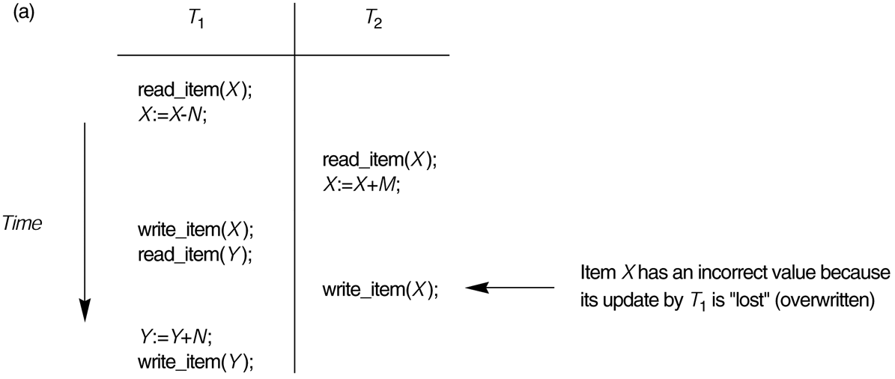
Some problems that occur when concurrent execution is uncontrolled.
(a) The lost update problem.
Chapter 17-<number>

Slide 11
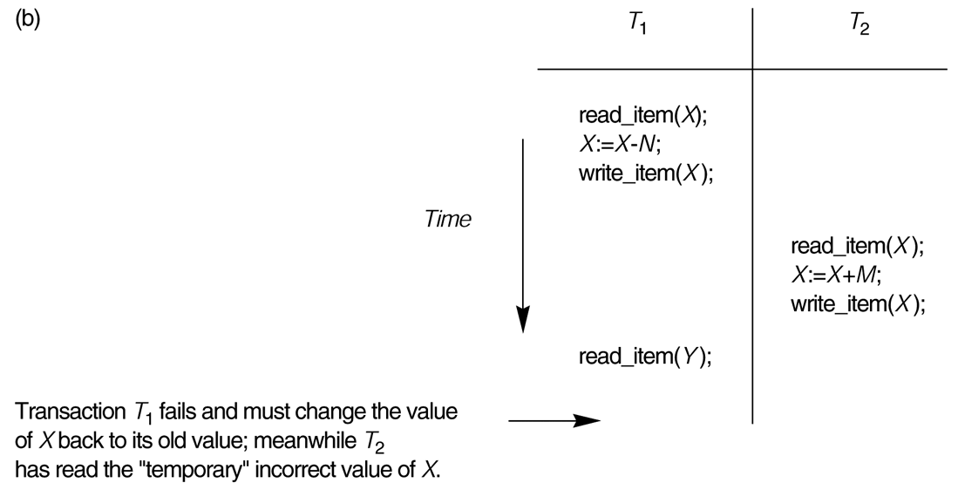
Some problems that occur when concurrent execution is uncontrolled.
(b) The temporary update problem.
Chapter 17-<number>

Slide 12
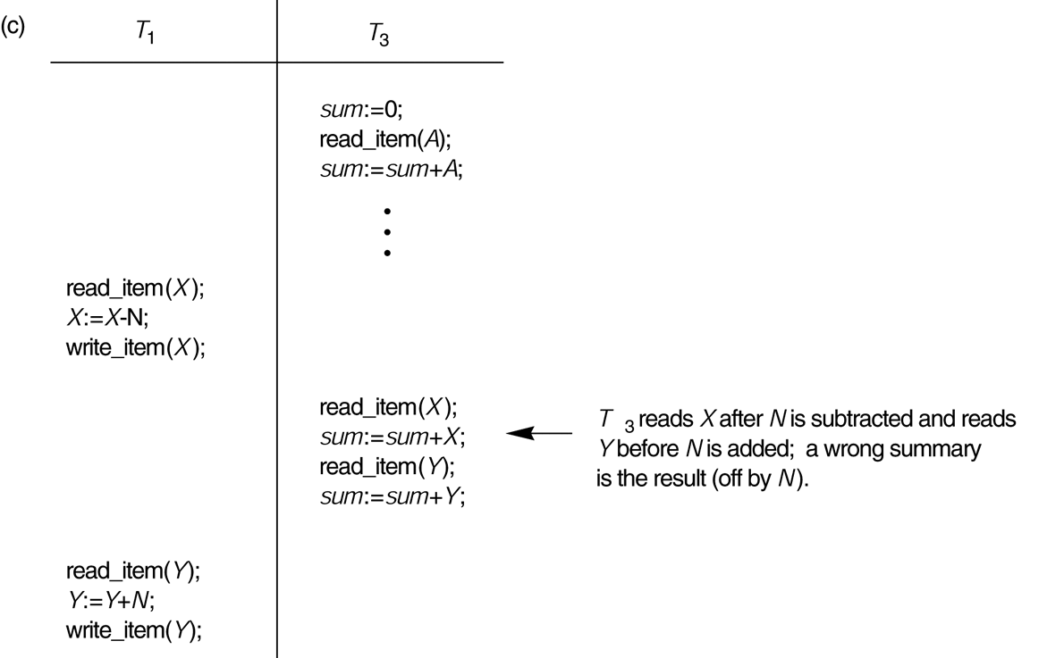
Some problems that occur when concurrent execution is uncontrolled.
(c) The incorrect summary problem.
Chapter 17-<number>

Slide 13
Why recovery is needed
What causes a Transaction to fail?:
A computer failure (system crash
A transaction or system error
Local errors or exception conditions
Concurrency control enforcement
Disk failure
Physical problems and catastrophes
Chapter 17-<number>

Slide 14
2 Transaction and System Concepts
Chapter 17-<number>

Slide 15
Transaction and System Concepts
A transaction is an atomic unit of work that is either completed in its entirety or not done at all. For recovery purposes, the system needs to keep track of when the transaction starts, terminates, and commits or aborts.
Transaction states:
Active state
Partially committed state
Committed state
Failed state
Terminated State
Chapter 17-<number>

Slide 16
Transaction and System Concepts
Recovery manager keeps track of the following operations:
begin_transaction: This marks the beginning of transaction execution.
read or write: These specify read or write operations on the database items that are executed as part of a transaction.
end_transaction: This specifies that read and write transaction operations have ended and marks the end limit of transaction execution. At this point it may be necessary to check whether the changes introduced by the transaction can be permanently applied to the database or whether the transaction has to be aborted because it violates concurrency control or for some other reason.
Chapter 17-<number>

Slide 17
Transaction and System Concepts
Recovery manager keeps track of the following operations (cont):
commit_transaction: This signals a successful end of the transaction so that any changes (updates) executed by the transaction can be safely committed to the database and will not be undone.
rollback (or abort): This signals that the transaction has ended unsuccessfully, so that any changes or effects that the transaction may have applied to the database must be undone.
Chapter 17-<number>

Slide 18
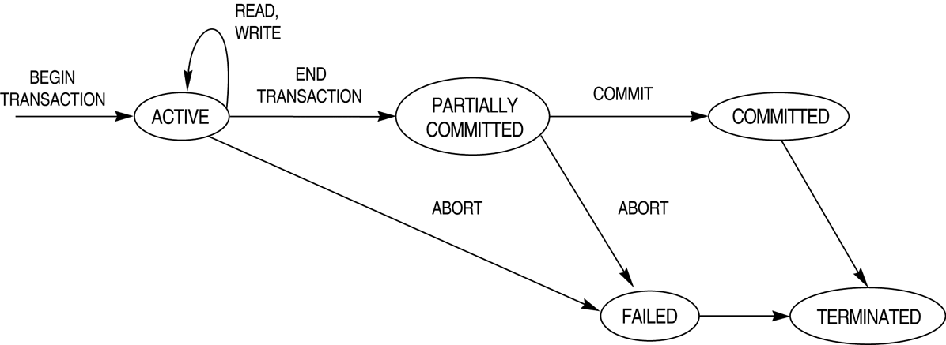
State transition diagram illustrating the states for transaction execution.
Chapter 17-<number>

Slide 19
3 Desirable Properties of Transactions
Chapter 17-<number>

Slide 20
Desirable Properties of Transactions
ACID properties:
Atomicity: A transaction is an atomic unit of processing; it is either performed in its entirety or not performed at all.
Consistency preservation: A correct execution of the transaction must take the database from one consistent state to another.
Chapter 17-<number>

Slide 21
Desirable Properties of Transactions
ACID properties (cont.):
Isolation: A transaction should not make its updates visible to other transactions until it is committed; this property, when enforced strictly, solves the temporary update problem and makes cascading rollbacks of transactions unnecessary (see Chapter 21).
Durability or permanency: Once a transaction changes the database and the changes are committed, these changes must never be lost because of subsequent failure.
Chapter 17-<number>

Slide 22
4 Characterizing Schedules based on Recoverability
(See also exercise 17.16)
Chapter 17-<number>

Slide 23
Characterizing Schedules based on Recoverability
A transaction schedule describes the sequential ordening of the operations from each transaction, for example the schedule
rd₁(X); X :=₁ X-N; rd₂(X); X :=₂ X+M; wr₁(X);rd₁(Y); wr₂(X); ...
corresponds with the following schema:
Chapter 17-<number>

Slide 24
Characterizing Schedules based on Recoverability
Schedules classified on recoverability:
Strict Schedule: A schedule in which a transaction can neither read or write an item X until the last transaction that wrote X has been committed.
Cascadeless schedule: One where every transaction reads only the items that are written by committed transactions.
Schedules requiring cascaded rollback: A schedule in which uncommitted transactions that read an item from a failed transaction must be rolled back.
Recoverable schedule: One where no terminated transaction needs to be rolled back.
A schedule S is recoverable if no transaction T in S commits until all transactions T’ that have written an item that T reads have committed.
Chapter 17-<number>

Slide 25
5 Characterizing Schedules based on Serializability
(See also exercise 17.17, 17.22)
Chapter 17-<number>

Slide 26
Characterizing Schedules based on Serializability
Serial schedule: A schedule S is serial if, for every transaction T participating in the schedule, all the operations of T are executed consecutively in the schedule. Otherwise, the schedule is called nonserial schedule.
Serializable schedule: A schedule S is serializable if it is equivalent to some serial schedule of the same n transactions.
Chapter 17-<number>

Slide 27
Characterizing Schedules based on Serializability
Result equivalent: Two schedules are called result equivalent if they produce the same final state of the database.
Conflict equivalent: Two schedules are said to be conflict equivalent if the order of any two conflicting operations is the same in both schedules.
Conflict serializable: A schedule S is said to be conflict serializable if it is conflict equivalent to some serial schedule S’.
Chapter 17-<number>

Slide 28
Characterizing Schedules based on Serializability
Being serializable is not the same as being serial
Being serializable implies that the schedule is a correct schedule.
  It will leave the database in a consistent state.
  The interleaving is appropriate and will result in a state as if the transactions were serially executed, yet will achieve efficiency due to concurrent execution.
Chapter 17-<number>

Slide 29
Characterizing Schedules based on Serializability
Serializability is hard to check.
  Interleaving of operations occurs in an operating system through some scheduler
  Difficult to determine beforehand how the operations in a schedule will be interleaved.
Chapter 17-<number>

Slide 30
Algorithm to test for conflict serializability
Consider the read_Item (X) and write_Item (X) operations
Construct a precedence graph (serialization graph) - a graph with directed edges
Create an edge from T_{i} to T_{j} if one of the operations in T_{i} appears before a conflicting one in T_{j}
(only read/write and write/write combinations)
The schedule is serializable if and only if the precedence graph has no cycles.
Chapter 17-<number>

Slide 31
Schedule A
T1 rd(X); X := X – N; wr(X); rd(Y); Y := Y + N; wr(Y); | T2 rd(X); X := X + M; wr(X);
T₁
T₂
X
Schedule A is a serial schedule, first T₁ and then T₂
Chapter 17-<number>

Slide 32
Schedule B
T1 rd(X); X := X – N; wr(X); rd(Y); Y := Y + N; wr(Y); | T2 rd(X); X := X + M; wr(X);
T₁
T₂
X
Schedule B is a serial schedule, first T₂ and then T₁
Chapter 17-<number>

Slide 33
Schedule C
X
T1 rd(X); X := X – N; wr(X); rd(Y); Y := Y + N; wr(Y); | T2 rd(X); X := X + M; wr(X);
T₁
T₂
X
Schedule C is a non serial schedule, it is not serializable either (i.e., it is not equivalent to some serial schedule, as is shown by the cycle in the dependency graph).
Chapter 17-<number>

Slide 34
Schedule D
T1 rd(X); X := X – N; wr(X); rd(Y); Y := Y + N; wr(Y); | T2 rd(X); X := X + M; wr(X);
T₁
T₂
X
Schedule D is a non-serial schedule, it is serializable as it is conflict equivalent with schedule A (first T₁, then T₂; logically seen T₁ may execute its operations on Y before or after T₂)
Chapter 17-<number>

Slide 35
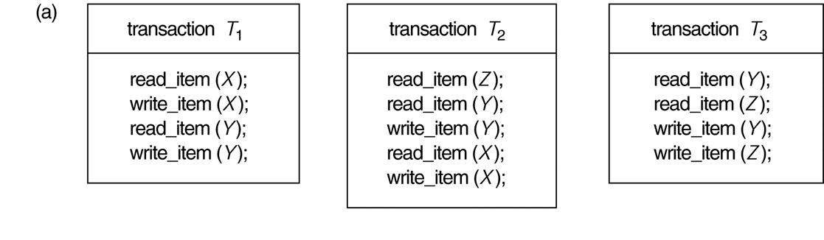
Another example of serializability testing.
The READ and WRITE operations of three transactions T₁, T₂, and T₃.
Chapter 17-<number>

Slide 36
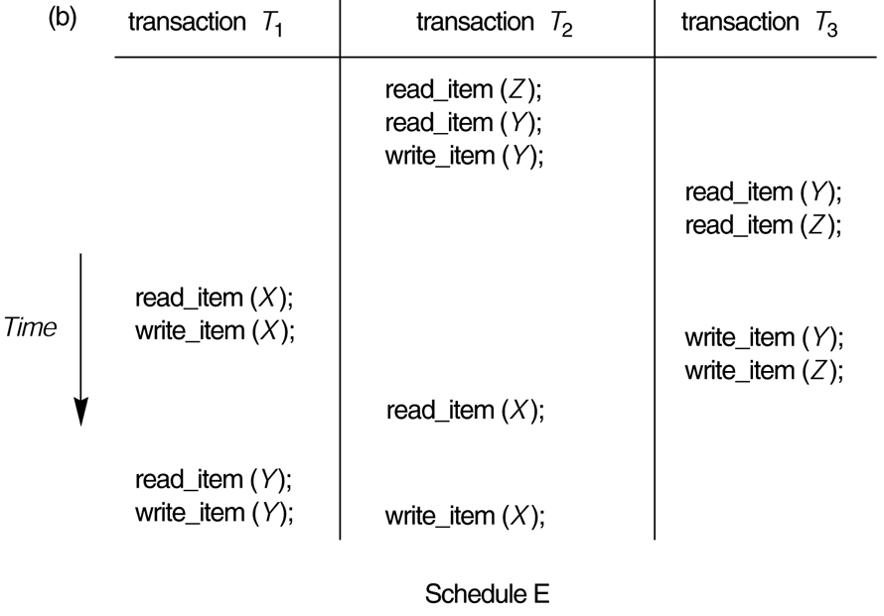
Schedule E.
Chapter 17-<number>

Slide 37
Precedence Graph Schedule E
Y
T₁
T₂
X
Y
Y,Z
T₃
Schedule E contains cycles, hence it is not equivalent to any serial schedule
Chapter 17-<number>

Slide 38
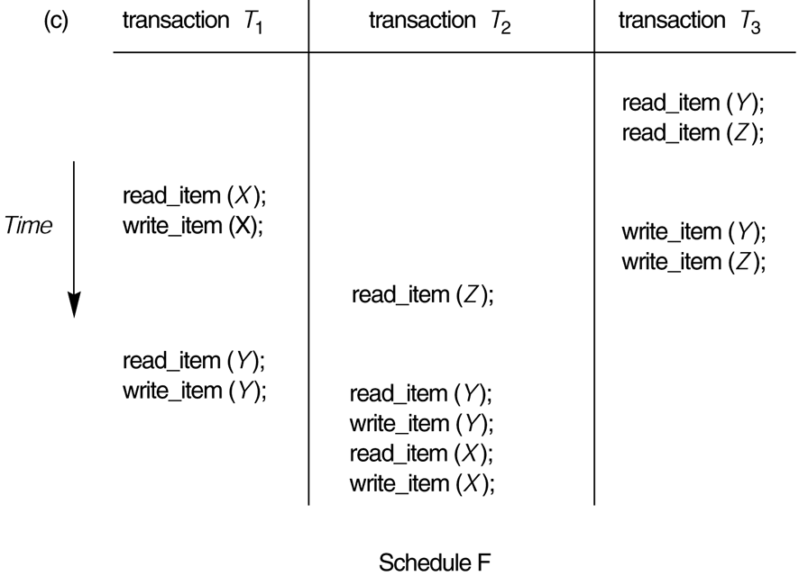
Schedule F.
Chapter 17-<number>

Slide 39
Precedence Graph Schedule F
X,Y
T₁
T₂
Y
Y,Z
T₃
Schedule F contains no cycles, it is serializable because it is equivalent to the serial schedule T₃ → T₁ → T₂
Chapter 17-<number>

Slide 40
6 Transaction Support in SQL
Chapter 17-<number>

Slide 41
Transaction Support in SQL
A single SQL statement is always considered to be atomic. Either the statement completes execution without error or it fails and leaves the database unchanged.
With SQL, there is no explicit Begin Transaction statement. Transaction initiation is done implicitly when particular SQL statements are encountered.
Every transaction must have an explicit end statement, which is either a COMMIT or ROLLBACK.
Chapter 17-<number>

Slide 42
Transaction Support in SQL
Sample SQL transaction:
EXEC SQL whenever sqlerror go to UNDO;
EXEC SQL SET TRANSACTION
READ WRITE
DIAGNOSTICS SIZE 5
ISOLATION LEVEL SERIALIZABLE;
EXEC SQL INSERT
INTO EMPLOYEE (FNAME, LNAME, SSN, DNO, SALARY)
VALUES ('Robert','Smith','991004321',2,35000);
EXEC SQL UPDATE EMPLOYEE
SET SALARY = SALARY * 1.1
WHERE DNO = 2;
EXEC SQL COMMIT;
GOTO THE_END;
UNDO: EXEC SQL ROLLBACK;
THE_END: ...
Chapter 17-<number>

Slide 43
7 The two phase protocol (Chp 18)
Chapter 17-<number>

Slide 44
Database Concurrency Control
Locking Techniques
  Locking is an operation which secures (a) permission to Read or (b) permission to Write a data item for a transaction. Example: Lock (X). Data item X is locked on behalf of the requesting transaction.
  Unlocking is an operation which removes these permissions from the data item. Example: Unlock (X). Data item X is made available to all other transactions.
  Lock and Unlock are Atomic operations.
  Write-lock: if a transaction holds a write-lock on some item X, no other process can access X
  Read-lock: if a transaction holds a read-lock on some item X, other processes can only obtain another read-lock on X, but never a write-lock.
Chapter 17-<number>

Slide 45
Database Concurrency Control
Two-Phase Locking Techniques: The algorithm
Two Phases: (a) Locking (Growing) (b) Unlocking (Shrinking).
Locking (Growing) Phase: A transaction applies locks (read or write) on desired data items one at a time.
Unlocking (Shrinking) Phase: A transaction unlocks its locked data items one at a time.
Two-phase protocol: Each transaction first obtains all locks (locking phase), then it may free it locks (unlocking phase). Hence, no unlock (of some item X) may be preceded by any lock (of some item Y).
Chapter 17-<number>

Slide 46
The two phase protocol guarantees conflict serializability
Proof by contradiction.
Suppose we have n transactions T₁, T₂, ..., T_{n} such that they all obey the basic two-phase locking rule (i.e. no transaction has an unlock operation followed by a lock operation). Suppose that (by contradiction) it would not guarantee conflict serializability, then a non-(conflict)-serializable schedule S for T₁, T₂, ..., T_{n} does occur, in which case the precedence (serialization) graph for S must have a cycle. Hence, there must be some sequence within the schedule of the form:
S: ...; [o₁(X₁); ...; o₂(X₁);] ...; [ o₂(X₂); ...; o₃(X₂);] ... ; [o_{n}(X_{n}); ...; o’₁(X_{n});]...
where each pair of operations between square brackets [o_{i}(X_{i}),o_{i+1}(X_{i})] are conflicting (either [wr,wr], or [wr, rd], or [rd,wr]) in order to create an arc in the serialization graph. This implies that in transaction T₁, a sequence of the following form occurs:
T₁: ...; o₁(X₁); ... ; o’₁(X_{n}); ...
Furthermore, T₁ has to unlock item X₁ (so T₂ can lock it before applying o₂(X₁) to follow the rules of locking) and has to lock item X_{n} (before applying o₁(X_{n}), but this must occur after T_{n} has unlocked it). Hence, a sequence in T₁ of the following form occurs:
T₁: ...; o₁(X₁); ...; unlock(X₁); ... ; lock(X_{n}); ...; o’₁(X_{n}); ...
This implies that T₁ does not obey the two-phase locking protocol (since lock(X_{n}) follows unlock(X₁)), contradicting our assumption that all transactions in S follow the two-phase locking protocol.
Chapter 17-<number>

